Slide 2
OCP Network Stack:
Common Components for
Three Very Different Use-Cases
Kyle Forster – Big Switch Networks
Vivek Shah – Google
Rob Sherwood – Facebook
Notes:
Author’s listed alphabetically by last name. Do we add Jim Wanderer as well?

Slide 3
Google, Facebook & Big Switch Demo
Next generation network operating systems based on Open Network Linux
Kyle Forster – Big Switch Networks
Vivek Shah – Google
Rob Sherwood – Facebook
Notes:
Author’s listed alphabetically by last name. Do we add Jim Wanderer as well?

Slide 4

Networking is in a Renaissance
A network with agility, automation and architected for change
OCP is driving this change!
Your Users
Notes:
Open hardware and open source are creating new ways to run networks
This picture is public domain! As attributed from https://commons.wikimedia.org/wiki/File:Creation-of-adam.PNG
Centralized/SDN vs. Distributed Control
Legacy support vs. clean slate

Slide 5

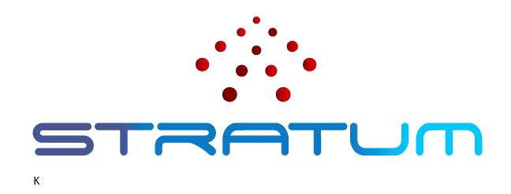

Different Uses / Common Components
1. Facebook
2. Big Switch
3. Google
Open/R
Notes:
ONL logo: owned by open compute project
Wedge switch logo: owned by open compute project (or Facebook?)

Slide 6

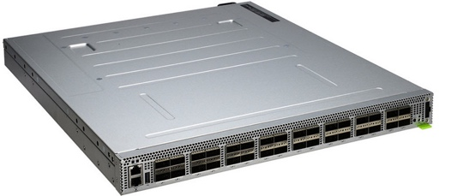
Different Uses / Common Components
1. Facebook
2. Big Switch
3. Google
Open/R
Open Network Linux
Notes:
ONL logo: owned by open compute project
Wedge switch logo: owned by open compute project (or Facebook?)

Slide 7
Different Uses / Common Components
1. Facebook
2. Big Switch
3. Google
Open/R
Open Network Linux
Notes:
ONL logo: owned by open compute project
Wedge switch logo: owned by open compute project (or Facebook?)

Slide 8
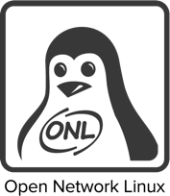
Open Network Linux is the Glue
ONL is a Linux distribution for Open Network Switches
  Provides platform abstractions, default kernel configurations, libraries and drivers needed to run Linux on a modern data center switch
  Support for 68 switches and counting!
ONL decouples forwarding agent from underlying hardware platform: “Write once, run everywhere”
Insight: customized forwarding, collaborate on firmware
Contributed to OCP project in 2015
http://opennetworklinux.org

Slide 9
OCP Networking @ Facebook
In Production, we run:
  OCP hardware (wedge, wedge100, etc.)
  The same Linux distribution as our servers
  FBOSS : https://github.com/facebook/fboss
But, also need to run outside production proper:
  Lab development, vendor + ODM integration
  Bootstrapping into production
  Solution: use Open Network Linux
Notes:
“As we’ve talked about publicly before, we use Wedge, Wedge100, Backpack, etc. OCP hardware in our production data centers. One of the big wins for us is to be able to use the same Linux distribution that runs on our servers also on our switches. We then run the FBOSS switching software on top of that – almost the same version that’s available from github. But this software stack is fairly tightly coupled to services only available in the production network, in terms of logging, monitoring, Facebook specific libraries and binaries, etc. So when we want to run outside of the production specific security zone, for example, if we want to reproduce a bug with a component supplier or if we want the LEDs on the switches to work while our system integrators work on the devices before they even come to our DCs, we need a version of this stack that will work outside of production. For this, we build on Open Network Linux because it will allow us to port to different switches with minimal hassle and is quickly becoming the standard base switch Linux distribution”

Slide 10




OCP Networking @ Big Switch
Switching Fabrics for vCenter / NSX / Containers / OpenStack
*
Monitoring Fabrics for Datacenter Visibility
Security Fabrics for NG-DMZs
SDN Software for Open Networking Hardware
…
ONL based new products
  Solution: use Open Network Linux

Slide 11
OCP Networking Open For Business
3 of the top 10 SaaS leaders including and more
and five of the other
top 10 Financial Services co’s
, -- now 8 of the largest 20 global communication service providers
Leaders advancing healthcare like
4 of the leading 10 Retailers like
and some of the other most secure public clouds ever built
Disruptors like ,
revolutionizing transportation

Slide 12
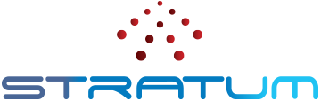
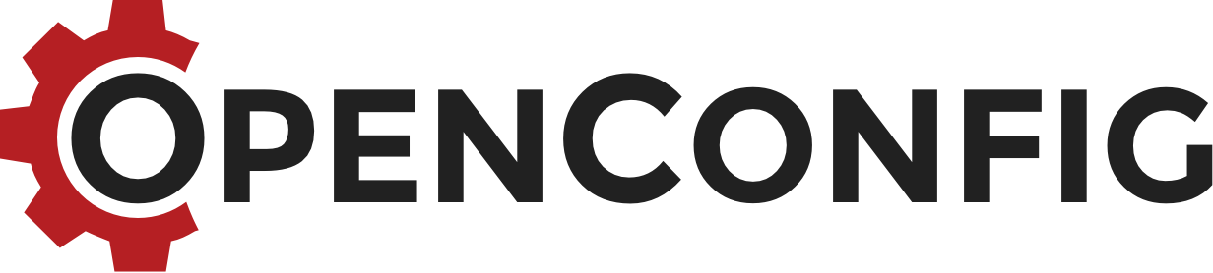
Google’s vision for Next gen Switch
Control
Management
P4 Runtime
+
+
P4 Runtime Agent
OpenConfig
gNMI
gNOI
Open Network Linux Platform
ASIC 1
ASIC 2
ASIC 3
ASIC 4
Notes:
At Google, we envision our next gen SDN based switch to be fast, be easy to program, manage , configure and provides an silicon and system level abstraction. We look forward for “Open Network Linux Platform ” for providing platform level abstraction and P4 Run time & OpenConfig for Switch-ASIC abstraction. We envision “Open Network Linux Platform ” will enable whitebox switch vendors to manufacture switches so that they can be deployed in Google’s data centers. We are working with Big Switch to enhance ONLP.

Slide 13
Joint Demo
1. Facebook
Thrift/JSON
2. Big Switch
FRR/Open Source BGP
3. Google
Controller-based P4
Open Network Linux
…
Notes:
ONL logo: owned by open compute project
Wedge switch logo: owned by open compute project (or Facebook?)

